Slide 1

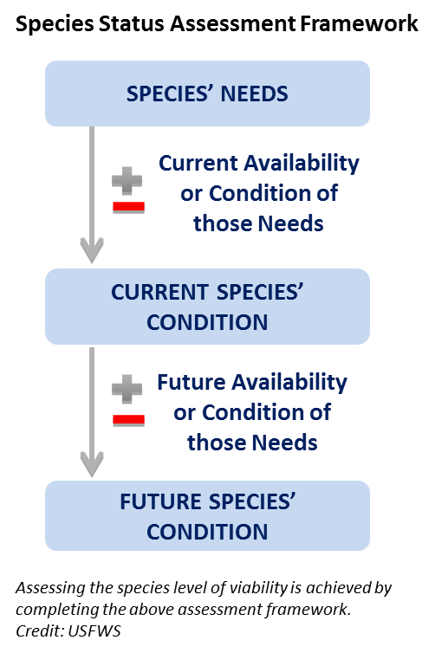
Species’ Needs
Notes:
Today we will focus our time on the first part of the SSA Analytical Process – the Species’ Needs (in some places it is referred to as Species’ Ecological Needs).
Stage 1: species’ ecological needs. Stage 1 of an SSA is an exploration of the species' life history and ecology including the biological requirements of the species at the individual or life-stage, population, and species levels. The SSA considers how the availability of habitat and other resources influence survival, reproduction, and migration. Stage 1 documents the life history profile, describes the factors affecting population resilience and redundancy, and explores how the species functions to maintain populations in areas representing significant geographic, genetic, or life history variation (i.e., the species’ ecological settings). Exploration of these relationships at the various levels lays the foundation for the next stages of the SSA Framework.

Slide 2
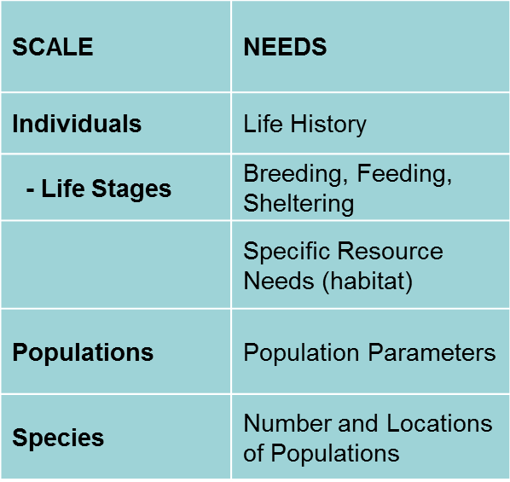
Species’ Needs
INDIVIDUAL
Notes:
We will start at the INDIVIDUAL scale, looking at the life history and identifying each life stage, and what is NEEDED for breeding, feeding, and sheltering. What are the specific RESOURCES needed for individuals to complete their life cycle?
Then we will scale our discussion up to the population and species levels.
So, think back to the Page Springsnail…

Slide 3
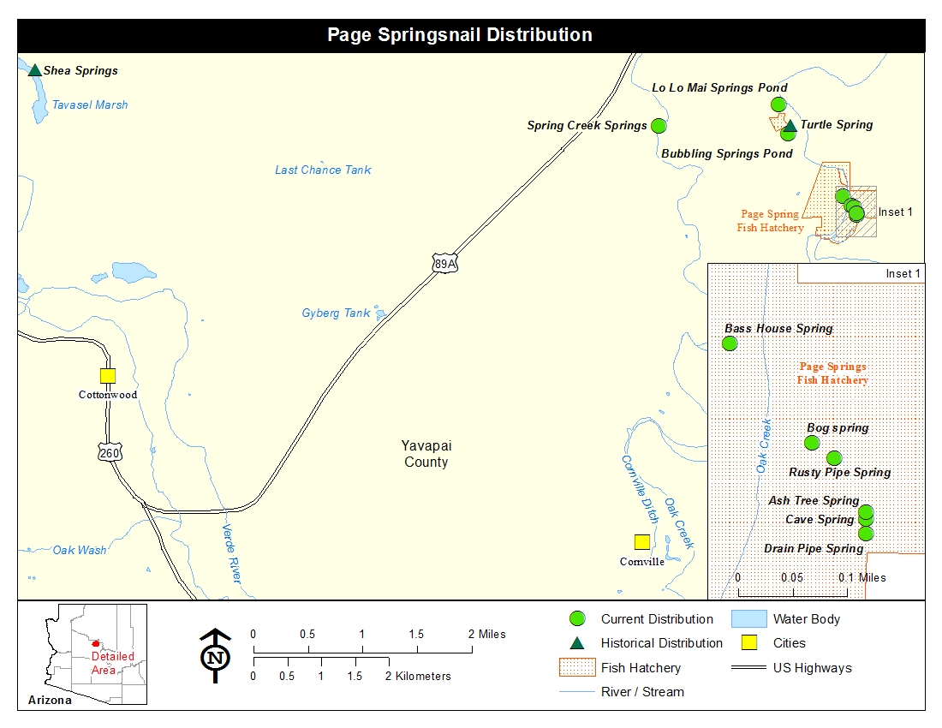
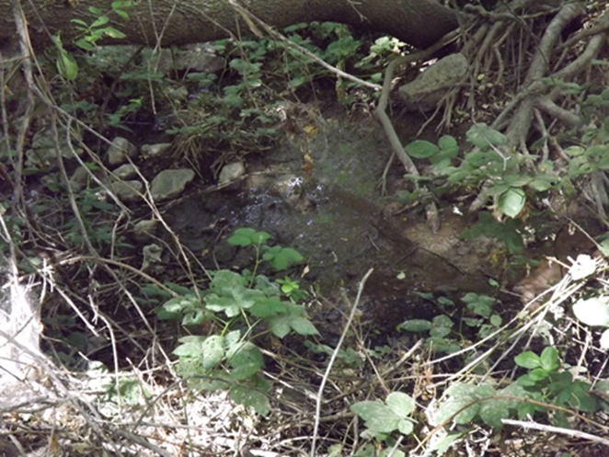
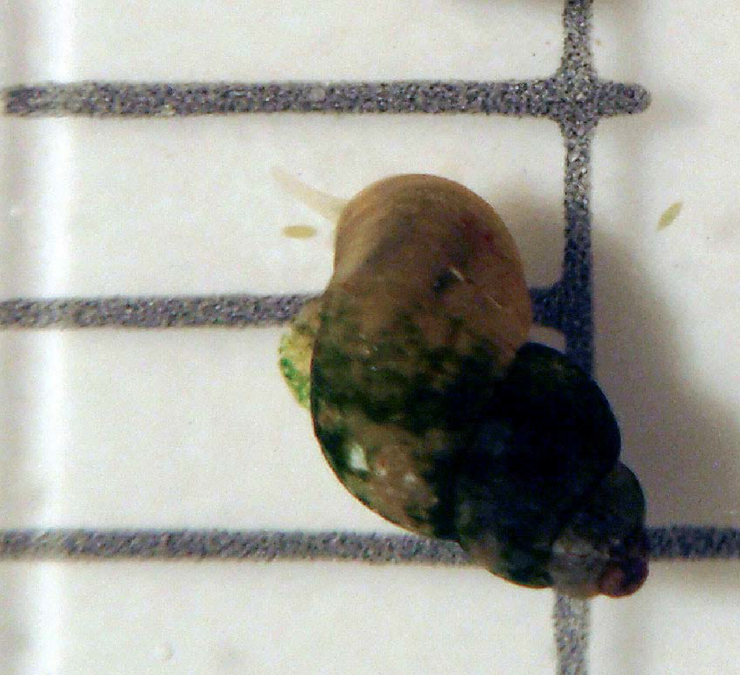
Species’ Needs
INDIVIDUAL
Notes:
…the case study SSA. (They should have all seen the case study video.)
What general information about the ecology of the species can you remember?
(Maybe list their responses on a flip chart or marker board)…some answers could be:
- it has a bunch of populations, some extirpated
- it lives in springs, does not do well in impoundments
- good habitat has spring flow discharge, water quality, suitable substrate, vegetation
- drought and ground water flow are concerns
Even though the case study video did not go into a lot of detail, the SSA started with a description of the taxonomy of the species and what was known about its life history and habitat. Then it explored what INDIVIDUALS NEEDED…what resources and circumstances does the springsnail NEED to complete its life cycle?
Where would you find that kind of information? (primarily from the literature)
(Answers could include…peer-reviewed papers, resource agency data, state Natural Heritage databases, graduate research, etc…)
After discussing the needs of individual springsnails, the SSA looked at what populations need to persist, and ultimately, what the species as a whole needed to be viable. (Ask who can remember from yesterday what we mean by “viability”)

Slide 4

Species’ Needs
INDIVIDUAL
Informal information-sharing meeting
Notes:
We may have experts in house, but this is a great point to have an informational meeting. This is not “required”, but it sure is a good idea!
What’s the latest that’s known based on current research? Convene those that are working on the species (the experts) and have an introductory meeting to start things rolling. This also helps gain their buy-in for later in the process and starts us out on the right path.
Opening the dialogue
In-person meeting
Webinar/conference call
Best to be in-person to ENGAGE folks from the beginning.
In the beginning of this meeting you might brainstorm the information that we will be discussing today – the taxonomy and life history. If you have the luxury of having the experts in-house for a whole day, you could progress to developing a conceptual model based upon what is known now. (We will be doing this in class tomorrow morning)

Slide 5
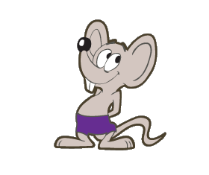
Species’ Needs
INDIVIDUAL
Taxonomy
Life history
Habitat
Ecological Needs at
Individual level
Population level
Species level
Notes:
An SSA begins with a compilation of the best available biological information on the species. This stage of the SSA is an exploratory one – to help us understand how the species is maintained over time.
(click) The taxonomy describes what is known about the species from a classification perspective. Identify the species, populations, genetic isolation, whatever is known about how it is classified.
(click) Life History includes developmental stages, age at maturity, migratory patterns, predator/prey relationships, and other factors important to understanding the natural history of the species and ecological relationships.
(click) Of course it is important to describe the species habitat, from broad ecological settings to specific habitat components.
(click) What are the ecological NEEDS at the individual, population, and species level based upon how factors are understood to act on the species and its habitat?
We will look more closely at each of these this morning.

Slide 6
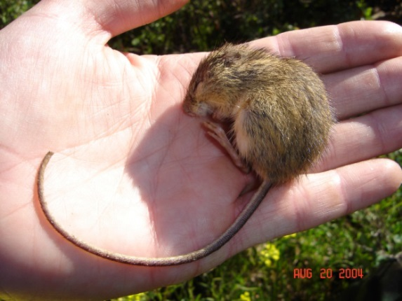
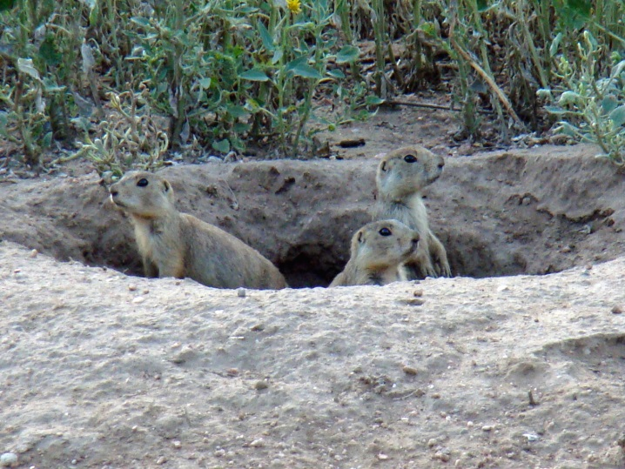
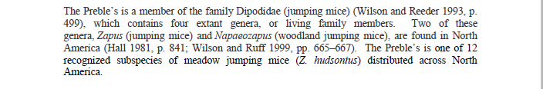
Species’ Needs
INDIVIDUAL
Taxonomy
Preble’s Jumping Mouse
Gunnison’s Prairie Dog
Notes:
First things first, Taxonomy.
An SSA needs to include as much taxonomy as needed for the analysis and to address any taxonomic controversy.
For example, the Preble's Jumping Mouse and Gunnison's prairie dog findings required rather lengthy taxonomic discussions to solidify the listable entities. Preble's had a long history of taxonomic debate, not necessarily all controversial, but sufficiently complex to warrant a robust discussion in the SSA.
CRAIG, could you add a couple more sentences about the complexity addressed in PJM and GPD?
For the Island Mouse, our focal species this week, there is a single species found only on one island. There are no subspecies described, but there has been relatively little genetic work on the species. The taxonomy for Island Mouse is very straight-foward compared to Preble’s or Gunnison’s.

Slide 7
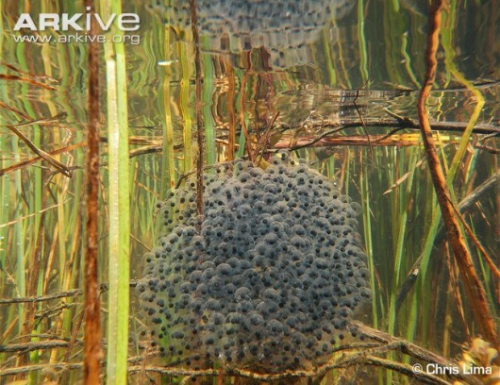
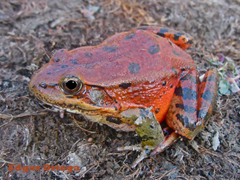
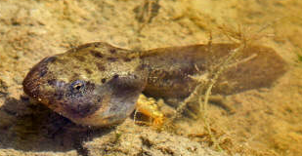
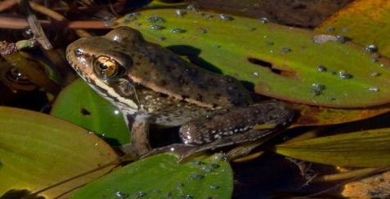
Species’ Needs
INDIVIDUAL
Life History
Notes:
Next, describe the “life history” of the species’ individuals.
What are developmental stages? For example, a frog would be (click each) “egg”, “larvae”, “subadult”, “adult”. Why is it important to start out by “deconstructing” the biology of the species this way?
answers could include:
-because different resources or circumstances could be needed in different life stages, in different places
-to help us understand the timing of each life stage
-to help us understand demographic needs (age classes, sex ratios, etc…)
It seems basic, but defining the life stages is a very important step.

Slide 8
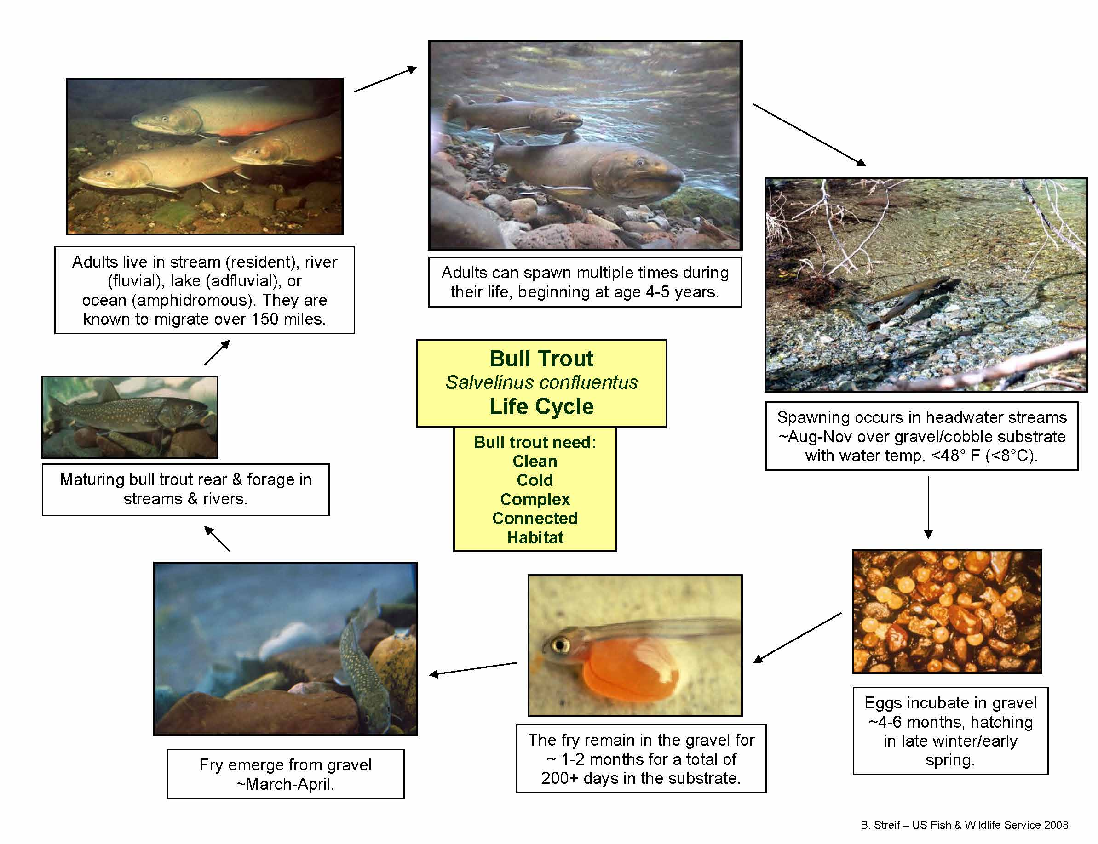
Species’ Needs
INDIVIDUAL
Notes:
Here is an example of a more complex Life Cycle conceptual model, for the bull trout.
(point out details that have been added).
Developing a life history profile is a good starting point for describing what influences individual survival and reproduction. In addition to basic needs, a life history profile documents those characteristics that make the species sensitive or resilient to particular natural or anthropogenic influences. For example, species with breeding site fidelity may be especially vulnerable to disturbance; or a generalist might be able to switch food sources as one gets scarce. The life history profile provides information for the assessment of the specie’s current condition (which we will discuss tomorrow) and for the species’ response over time (in other words, for understanding aspects influencing the species status…which we will explore Thursday.)

Slide 9
Species’ Needs
INDIVIDUAL
 | Jan | Feb | Mar | Apr | May | Jun | Jul | Aug | Sept | Oct | Nov | Dec
Year 1 |  |  | Egg development
 |  |  |  | Larval development/aquatic foraging
 |  |  |  |  |  |  | Metamorphosis
 |  |  |  |  |  |  | Terrestrial foraging, dispersal
 |  |  |  |  |  |  |  | Migration to hibernacula
 | Hibernation |  |  |  |  |  |  |  |  |  | Hibernation
Sub-adults |  |  |  | Emergence
 |  |  |  | Migration and foraging
 |  |  |  |  |  | (some aestivation?)
 |  |  |  |  |  |  |  | Migration to hibernacula
 | Hibernation |  |  |  |  |  |  |  |  |  | Hibernation
Adults |  |  | Emergence/migration to natal breeding sites
 |  |  | Egg deposition
 |  |  |  |  |  | (some aestivation?)
 |  |  |  | Migration and foraging
 |  |  |  |  |  |  |  | Migration to hibernacula
 | Hibernation |  |  |  |  |  |  |  |  |  | Hibernation
EGG
LARVA
SUB-ADULT
ADULT
Notes:
Then, once you know the basic life stages of individuals in your species, begin developing a life history profile. There are MANY ways to start capturing this information – here is just one example of a tabular way to organize your thinking about the individual’s life history.
Start with the life stages that you identified – for the frog, it was (click each) egg, larvae, sub-adult, and adult – and create a Table similar to a Gantt chart that shows where each stage happens in time. Because the frog takes three years to reach sexual maturity, we include the first three years in the Table.
By understanding what life stages are present – and where – at any given time, it becomes easier to determine how individuals are exposed to stressors (THREATS?) (not sure if you all want to use that word here!) that may influence their persistence over time.

Slide 10
Species’ Needs
INDIVIDUAL
1
2
3
4
5
EXERCISE 1.
Life Cycle
Jan | Feb | Mar | Apr | May | Jun | Jul | Aug | Sep | Oct | Nov | Dec
Notes:
For this exercise, Have them get into their population groups and diagram the life cycle of the Island Mouse. They should include information regarding timing, migration, or other circumstances necessary for completing the cycle, based upon what they know from the initial intro to the species. (Draw pictures in the large box and add description as appropriate). Then, transcribe life cycle information into the Gantt Chart (Table), representing one full year in the life of an Island Mouse, starting with birth. If you have additional details to add, use the lines at the bottom of the page for descriptive information.
(ANSWERS: There should be three life stages: Nestling, Juvenile, Adult. )

